Slide 1
Dynamic Pricing & Demand Forecasting for Fitness Classes
Revenue Optimization Using Data Analytics
By: Tejaswini Yeluduti

Slide 2

Project Overview & Business Problem
Objective
Develop a data-driven pricing strategy using:
Booking Trend Analysis
Demand Forecasting
Price Elasticity Analysis
Dynamic Pricing Algorithms
Business Challenges
Static Pricing Models
Fluctuating Booking Demand
Underutilized Class Capacity
Missed Revenue Opportunities

Slide 3
Data Cleaning & Preparation
Activities Performed:
Merged datasets
Handled Missing Values
Removed Duplicates
Corrected Data Types
Standardized Datetime Formats
Created Date Features

Slide 4
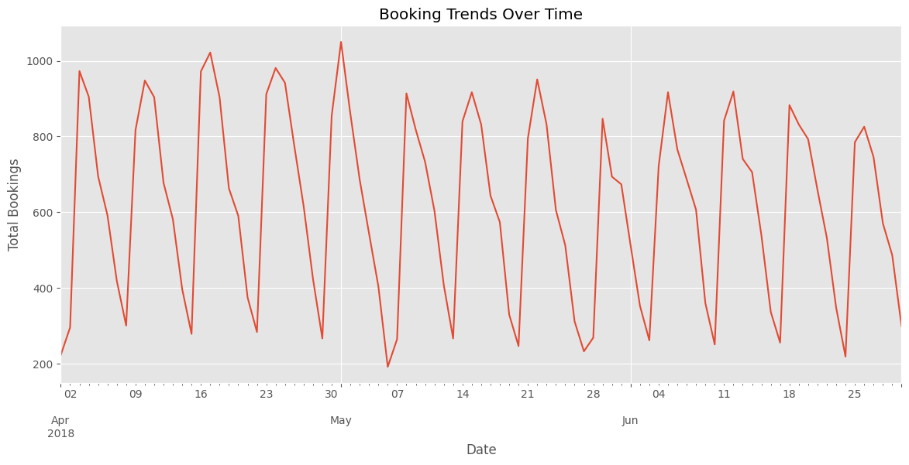
Exploratory Data Analysis (EDA)
Key Findings
Demand Varied Across Days And Months
Certain Classes Consistently Generated High Bookings
Occupancy Patterns Varied By Session Timing
Seasonal Trends Were Identified

Slide 5
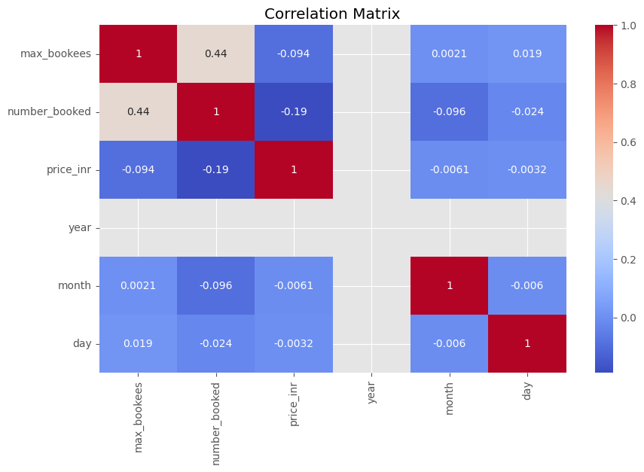
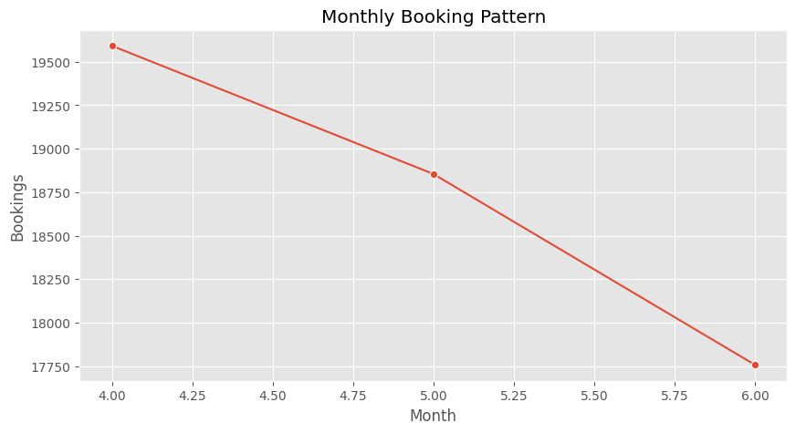
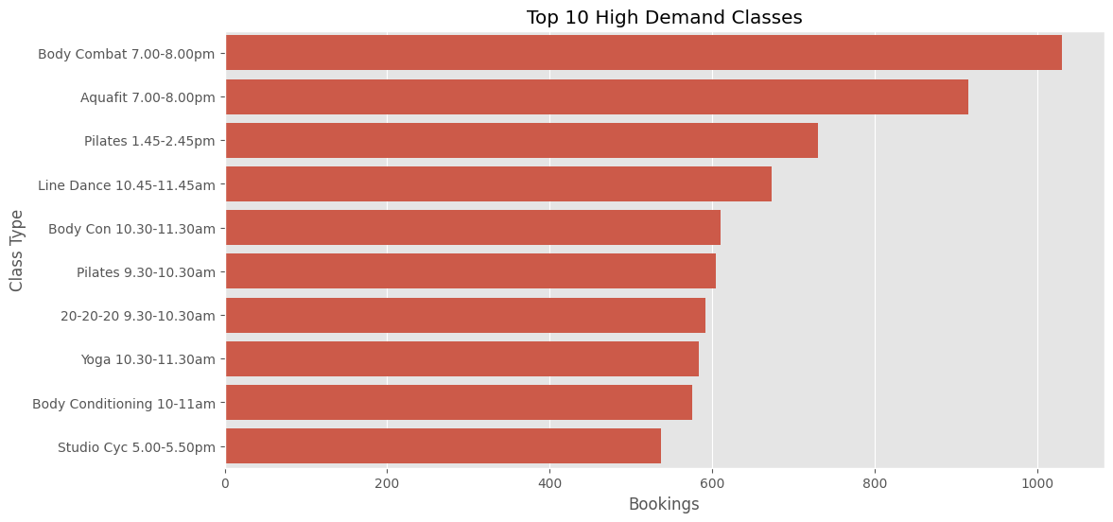
Charts
1
High-Demand Classes Chart
2
High-Demand Classes Chart
3
Correlation Heatmap

Slide 6
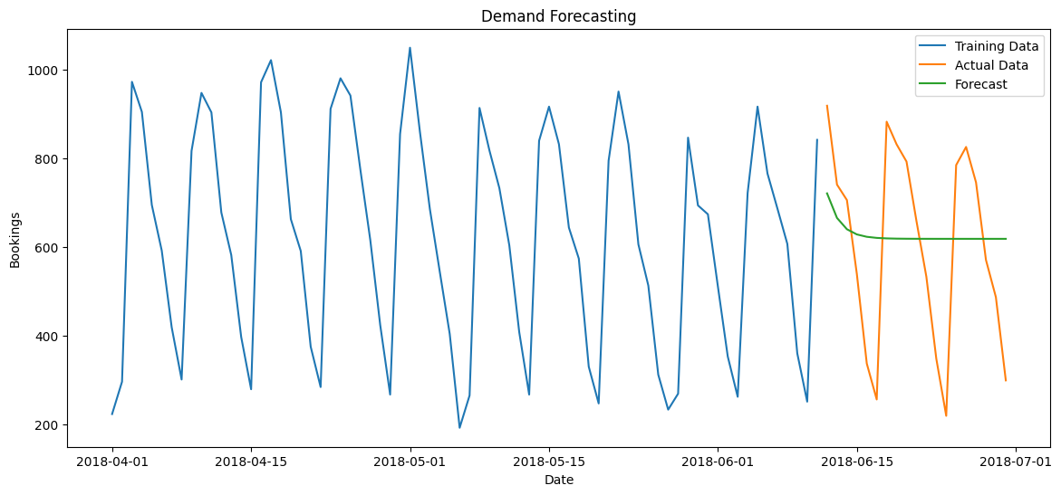
Price Elasticity & Demand Forecasting
Price Elasticity Insights
High-demand Classes Showed Lower Price Sensitivity
Premium Pricing Opportunities Identified
Demand Forecasting
ARIMA Model Used For Future Demand Prediction
Forecasting Supports Proactive Pricing Decisions

Slide 7
High-Demand Analysis
Key findings
Weekends and evening sessions showed higher occupancy
Recurring booking patterns identified
Specific classes generated consistently high demand
Business opportunity
Apply premium pricing during peak demand periods.

Slide 8
Dynamic Pricing Strategy
Pricing Logic
Demand Level | Occupancy Rate | Pricing Action
High Demand | >= 80% | +20% Price
Medium Demand | 50% - 79% | +10% Price
Low Demand | < 50% | -10% Price
Goal
Optimize pricing dynamically based on occupancy and booking demand.

Slide 9
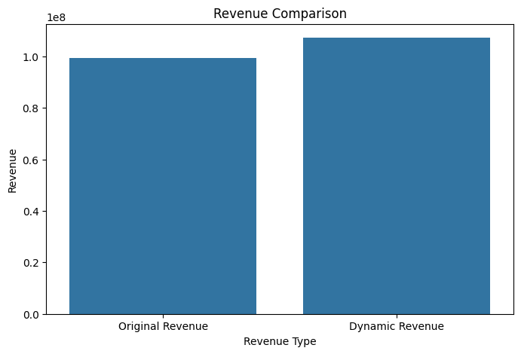
Revenue Optimization & Recommendations
Revenue Impact
Dynamic pricing demonstrated the potential to:
Improve Revenue Per Class
Increase Total Company Revenue
Improve Occupancy Utilization
Recommendations
Implement Occupancy-based Pricing
Optimize Instructor Scheduling
Monitor Booking Trends Continuously

Slide 10
Conclusion
This project demonstrated how analytics and forecasting can support:
Dynamic Pricing Optimization
Demand Forecasting
Revenue Growth
Operational Efficiency
The proposed solution provides a scalable framework for business optimization.

